Slide 1
Project 1: Hive on WikiMedia
Samuel L Owens

Slide 2
Which English Wikipedia article got the most traffic on October 20?
https://dumps.wikimedia.org/other/pageviews/2020/2020-10/pageviews-20201020-{00..23}0000.gz

Slide 3
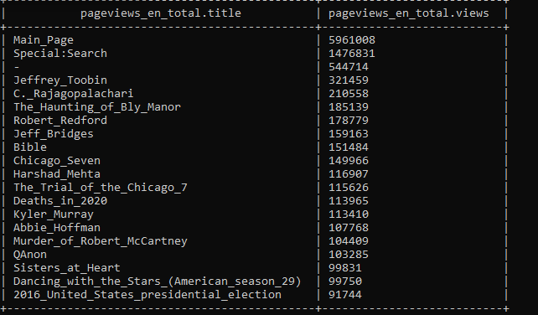
A table is created containing the number of views each article gets on each wikipedia article on 10/20
Each page receives 24 records, one for each hour in the day
An intermediary table is created containing only English page records
Another intermediary table is created combining the hourly records into one daily record

Slide 4
What English Wikipedia article has the largest fraction of its readers follow an internal link to another wikipedia article?
https://dumps.wikimedia.org/other/pageviews/2020/2020-10/pageviews-202009{01..30}-{00..23}0000.gz
https://dumps.wikimedia.org/other/clickstream/2020-09/clickstream-enwiki-2020-09.tsv.gz

Slide 5
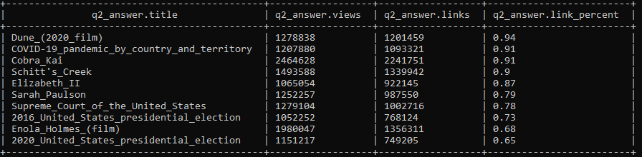
A table is created containing the number of viewers of each article from September 2020 that follow an internal link to another wikipedia page
Each page receives a record for each page that it links to
An intermediary table is created that sums up the number of times a viewer of the article follows any internal link
Another table is created containing the pageview records from September 2020
An intermediary table is created that sums up all of the activity for each page for the entire month
These two tables are joined together to provide the monthly readers of a page, the number of those readers that follow internal wikipedia links, and that ratio represented as a fraction

Slide 6
What series of wikipedia articles, starting with Hotel California, keeps the largest fraction of its reader through internal links
https://dumps.wikimedia.org/other/pageviews/2020/2020-10/pageviews-202009{01..30}-{00..23}0000.gz
https://dumps.wikimedia.org/other/clickstream/2020-09/clickstream-enwiki-2020-09.tsv.gz

Slide 7
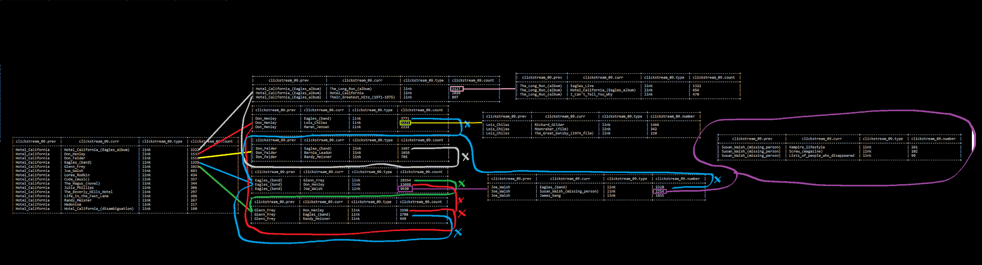
Any series that loops back on itself will be disregarded
When two series converge at one link, the series with more present viewers continues
Hotel_California links out a total of 13,779 of its readers to internal Wikipedia pages
From Hotel_California the top 5 internal Wikipedia pages linked to are found
From that top 5, their top 3 linked to pages are found
The series with the highest retention becomes clear after 4 levels
Hotel_California -> Eagles_(band) -> Joe_Walsh -> Susan_Walsh_(missing_person) -> Vampire_Lifestyle

Slide 8
Find an example of an English Wikipedia article that is relatively more popular in the UK, US, and Australia
https://dumps.wikimedia.org/other/pageviews/2020/2020-10/pageviews-20201020-{00..23}0000.gz
https://darknetdiaries.com/episode/13/

Slide 9
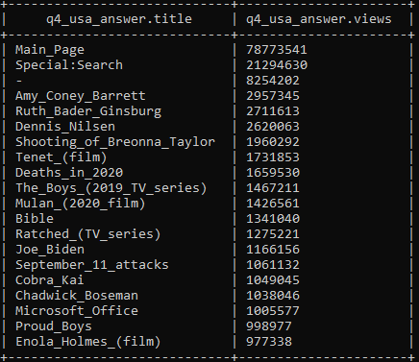
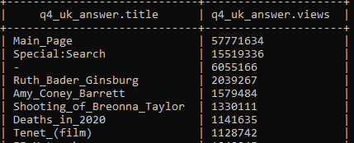
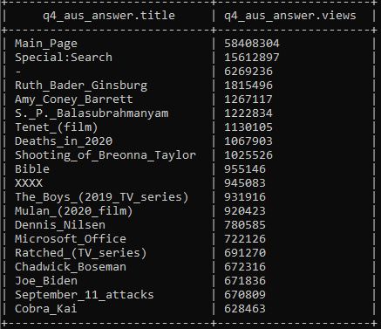
It would appear the hours of highest activity in the US are bracketed about Business hours
0900-1800 converted forward 5 hours for UTC is 1400-2300, this time frame is attributed to the US
The UK’s hours of highest activity span approximately form midday to sunset
1300 - 1800 UK time is the same as UTC and need not be adjusted
Australia appears to have some hours of activity in the early morning, followed by a lull, and more Activity towards the end of business hours
0700 - 1000 and 1400 - 1800 ACT converts to 1800 - 2100 and 0100 - 0500 UTC
A table is loaded for from the files representing the respective time spans
We repeat the process of the first question on each of these tables

Slide 10
Analyze how many users will see the average vandalized Wikipedia page before the offending edit is reversed
https://dumps.wikimedia.org/other/mediawiki_history/2020-10/enwiki/2020-10.enwiki.2020-09.tsv.bz2

Slide 11
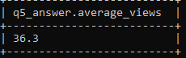

A table is created containing the 70 columns provided in the Wiki_History data set for September 2020
From the 70 only 2 are checked, one to verify that the record represents an edit being reverted and one to show the time in seconds before that edit was eventually reverted.
From this the average time a reverted edit is visible is calculated and a table is saved
The table has seconds, minutes, hours, and days
The result is an average visibility of just over 3 days
The average views a page gets in a month is then calculated from our previously created table of monthly view totals per page
This average is divided by 10 due to the average visibility time being roughly 10% of 30 days

Slide 12
By the same metric as the previous question, what is the most vandalized Article?
https://dumps.wikimedia.org/other/mediawiki_history/2020-10/enwiki/2020-10.enwiki.2020-09.tsv.bz2

Slide 13
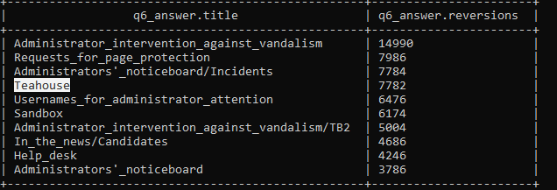
A table is created containing the 70 columns provided in the Wiki_History data set for September 2020
An intermediary table is created containing the number of times a revision is reverted on each page
Many of the top records appear to be internal pages for logging and administration but the top appears to be “Teahouse”

